Slide 1
The Rain Attenuation Prediction Models Submitted to ITU Recently and Problems?
Zhao Zhenwei
zhaozw22s@163.com

Slide 2
Content Outline
Rain Attenuation Prediction Models in ITU
Rain Attenuation Prediction Models
Comparisons of the Models
Problems of the Models
Time-Series Synthesizers of Rain Attenuation
Differential Rain Attenuation
Future Work

Slide 3
Several models for the prediction of long-term statistics of rain attenuation have been developed and submitted to ITU-R SG3 in the past ten years. five submitted by China, one submitted by UK, one submitted by Brazil and one submitted by Korea

Slide 4
All the prediction models can be divided into two groups.
One group estimates the exceeded attenuation of other percentages from the exceeded attenuation of 0.01% for an average year.
Another group uses the full rainfall rate probability distribution in the prediction. The method which use full rainfall rate probability distribution will be the trend for developing future rain attenuation models

Slide 5
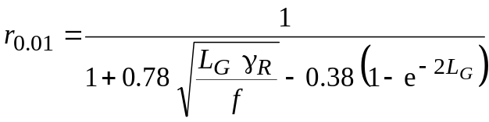
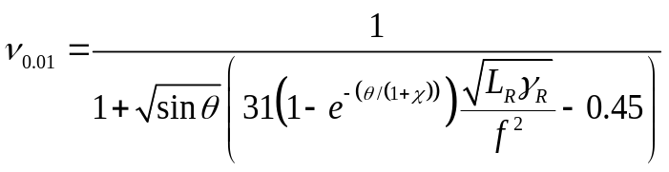
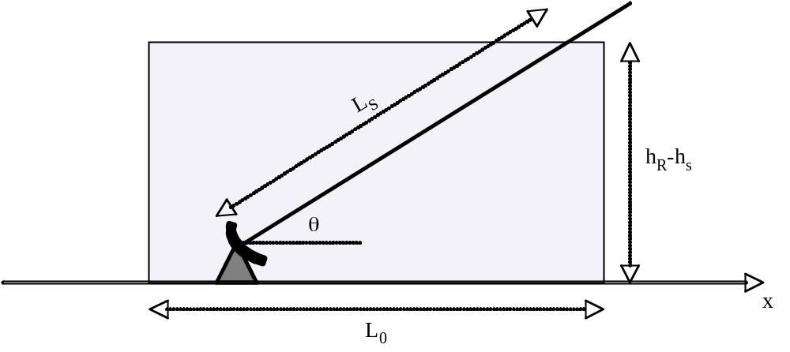
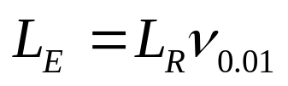
Prediction Model in ITU-R P.618
The model is based on the cylindrical rain cell. A horizontal reduction factor and a vertical adjustment factor are used to adjust the un-uniform distribution of rain rate along the path.
The horizontal reduction factor and vertical adjustment factor :
The effective path length:

Slide 6
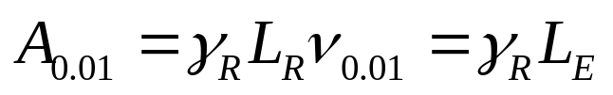
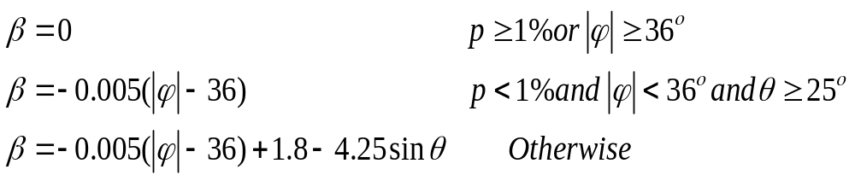
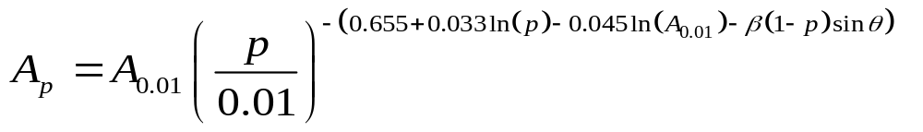
Prediction Model in ITU-R P.618
The attenuation exceeded for 0.01% of an average year:
The estimated attenuation to be exceeded for other percentages of an average year:

Slide 7
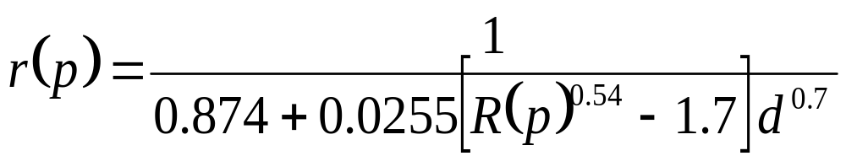
UK model
The model has two path adjustment factors which depend only on the rainfall rate and distance, and do not include any dependency on frequency and attenuation.
The horizontal and vertical path adjustment factor:
The slant-path attenuation:

Slide 8
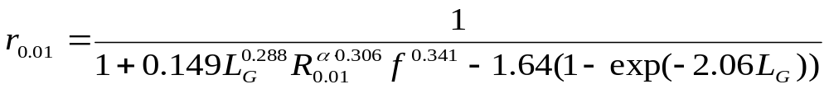
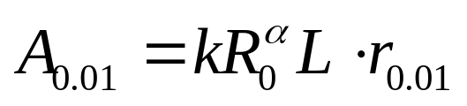
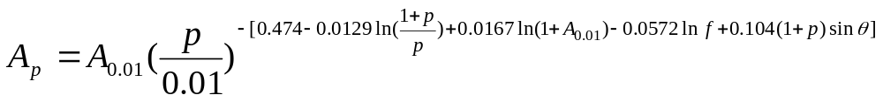
China_2005 model
The model is similar to the one in ITU-R P.618-10, where the path adjustment factor and the formula for estimating the exceeded attenuation of other percentages of an average year from the exceeded attenuation of 0.01% of an average year are developed.
The path adjustment factor:
The exceeded attenuation of 0.01% of an average year:
The predict attenuation to be exceeded for other percentages of an average year:

Slide 9
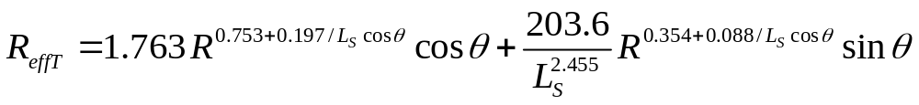
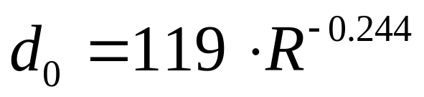
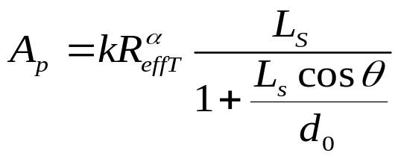
Brazil model
This method uses the conceptions of effective path length and effective rainfall rate to predict the attenuation.
The effective rainfall rate:
The equivalent cell diameter:
The cumulative distribution of rain attenuation:

Slide 10
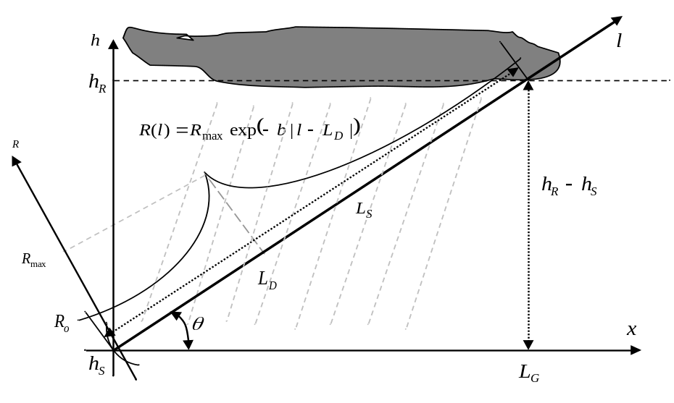
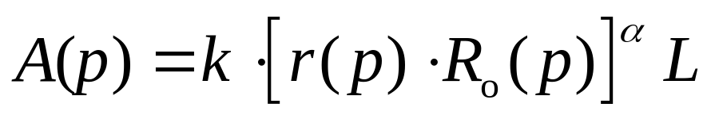
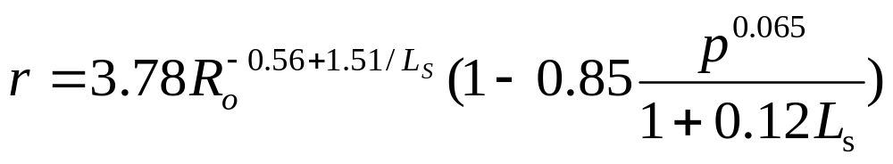
China_2012 model
The model is derived from the EXCELL rain cell in which a rain rate adjustment factor is obtained.
The predicted attenuation exceeded for p% of an averaged year:
The rain rate adjustment factor:

Slide 11
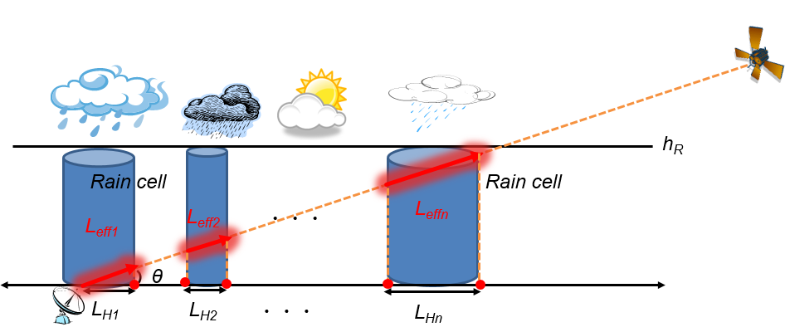
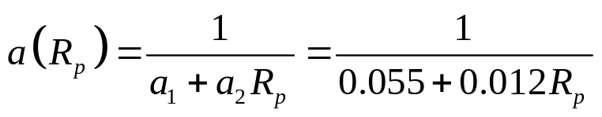


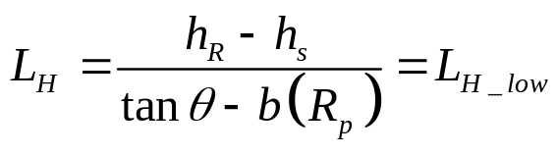
Korea model(1/2)
An effective path-length is introduced, which is purely dependent on the meteorological characteristics of rain cell distribution.
The rain cell radius and the rain cell slope:
The effective path length:
For R >{R_{0,}31.6}
For R <{R_{0,},31.6}

Slide 12





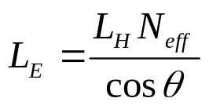
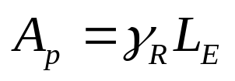
Korea model(2/2)
The effective number of rain cells:
For latitude < 23.5˚
For latitude≥ 23.5˚
The effective path length:
The predicted attenuation exceeded for p% of an average year:

Slide 13
Content Outline
Rain Attenuation Prediction Models in ITU
Rain Attenuation Prediction Models
Comparisons of the Models
Problems of the Models
Time-Series Synthesizers of Rain Attenuation
Differential Rain Attenuation
Future Work

Slide 14
Comparisons of the Models
Prediction model | MEAN (%) | RMS (%) | STD (%) | Weight years
ITU-R model | -5.31 | 31.78 | 31.33 | 90.59
China_2005 model | 0.35 | 28.55 | 28.55
UK model | 4.18 | 27.89 | 27.58 | 92.52
Brazil model | 9.43 | 30.72 | 29.24
China_2012 model | 0.00 | 24.41 | 24.41
Korea model | 0.19 | 25.76 | 25.76

Slide 15
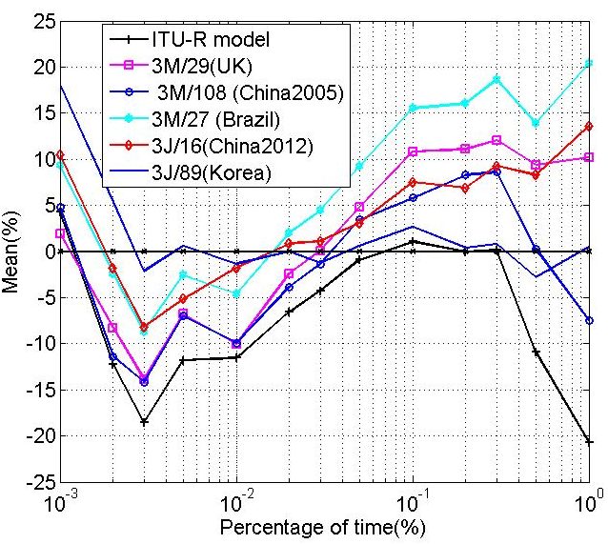
Comparison of Mean Values

Slide 16
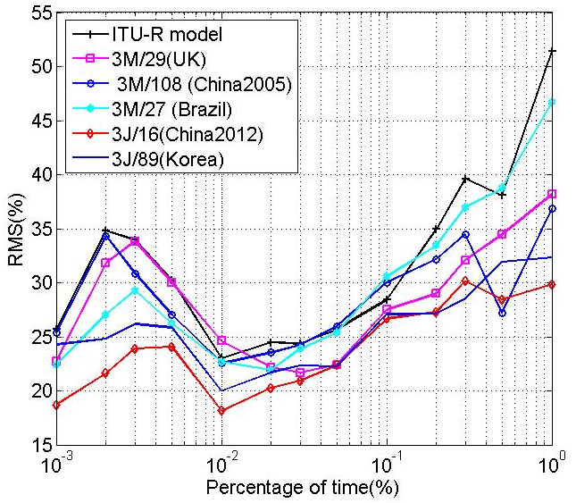
Comparison of RMS

Slide 17
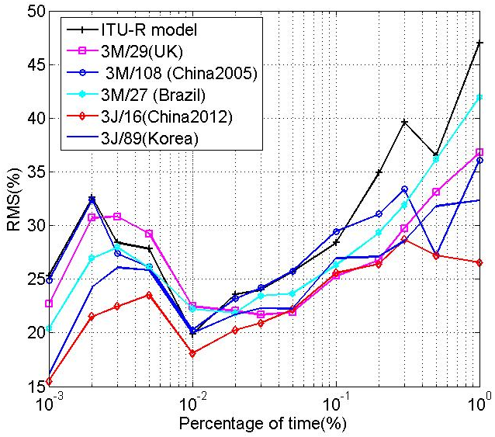
Comparison of STD

Slide 18
Comparisons of the models in low latitude
Prediction model | MEAN (%) | RMS (%) | STD (%) | Weight years
ITU-R model | -3.41 | 31.74 | 31.55 | 42.82
China_2005 model | -3.65 | 29.61 | 29.38
UK model | 4.26 | 24.41 | 24.04 | 44.77
Brazil model | 10.67 | 29.39 | 27.37
China_2012 model | 7.71 | 21.18 | 19.72
Korea model | -1.95 | 21.32 | 21.24

Slide 19
Content Outline
Rain Attenuation Prediction Models in ITU
Rain Attenuation Prediction Models
Comparisons of the Models
Problems of the Models
Time-Series Synthesizers of Rain Attenuation
Differential Rain Attenuation
Future Work

Slide 20
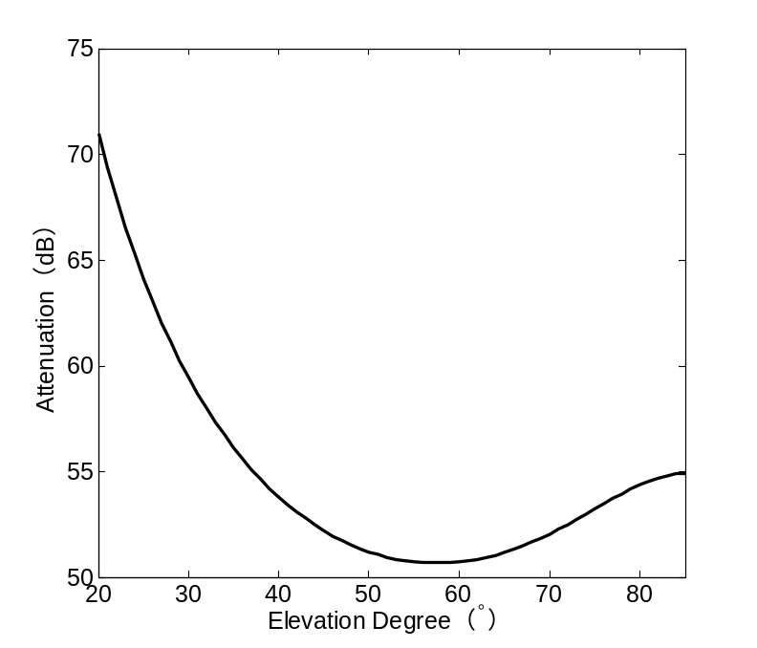
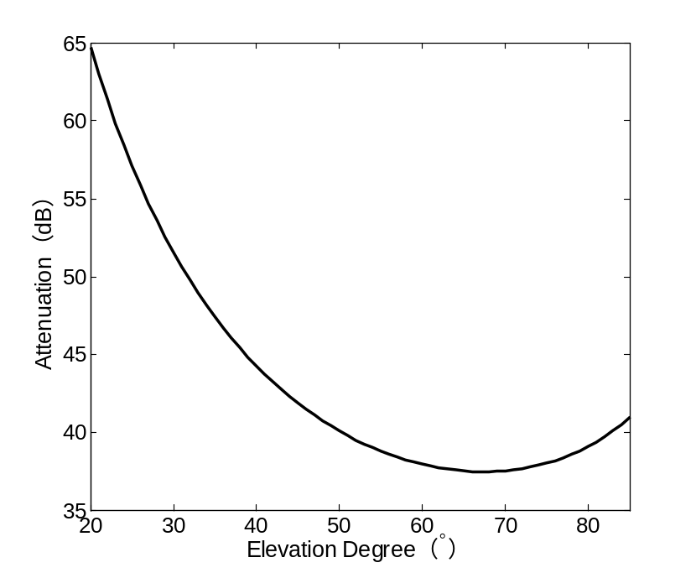
Predicted attenuation with elevation(1/3)
Frequency is 30 GHz, rain rate is 59 mm/h, rain height is 5km,latitude is 36ºN (In Qingdao, for example) .
ITU-R model
UK model

Slide 21
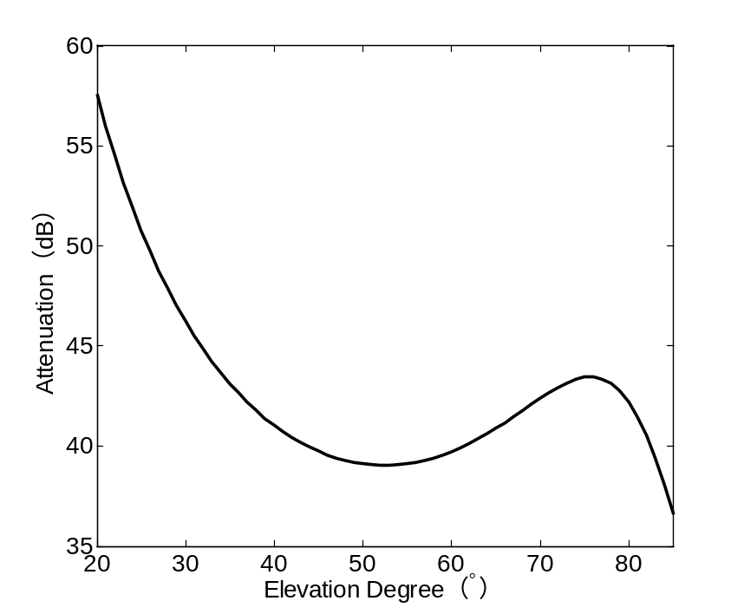
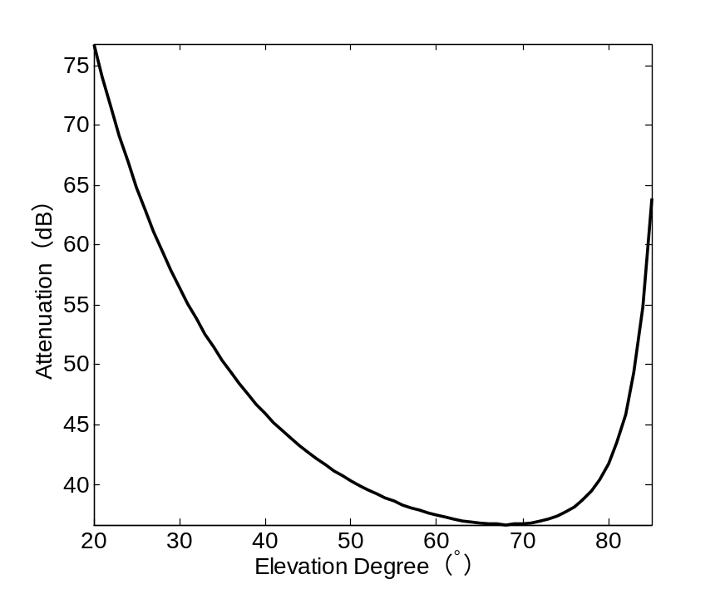
Predicted attenuation with elevation(2/3)
China_2005 model
Brazil model

Slide 22
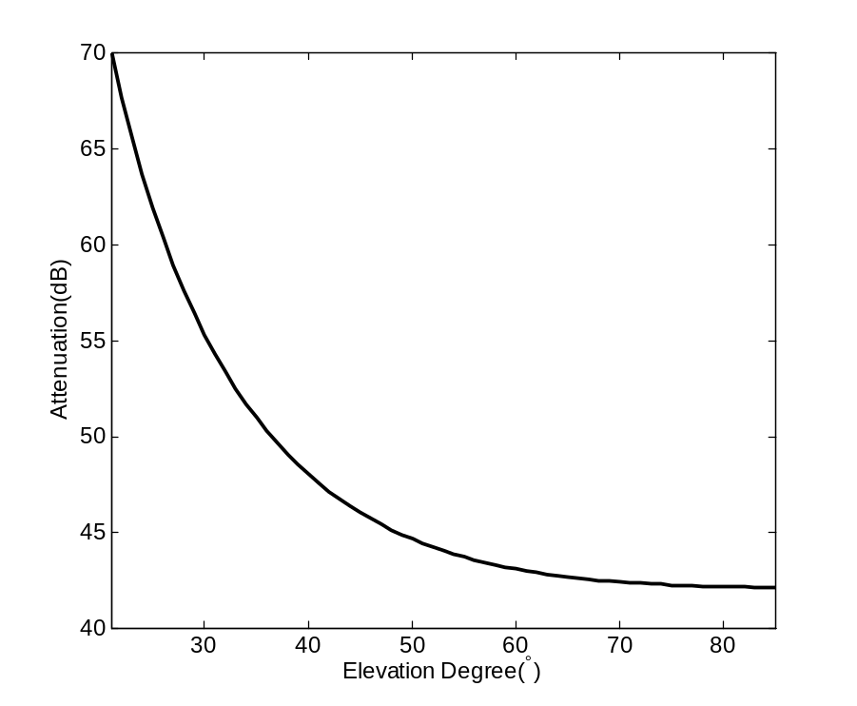
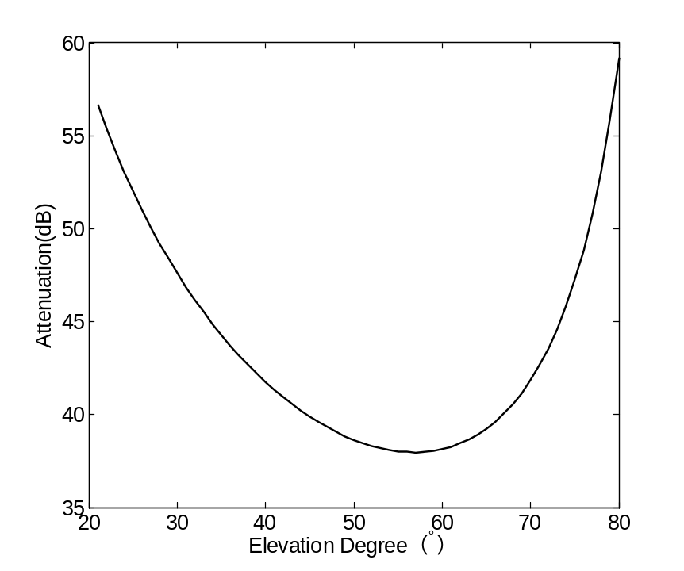
Predicted attenuation with elevation(3/3)
China_2012 model
Korea model

Slide 23
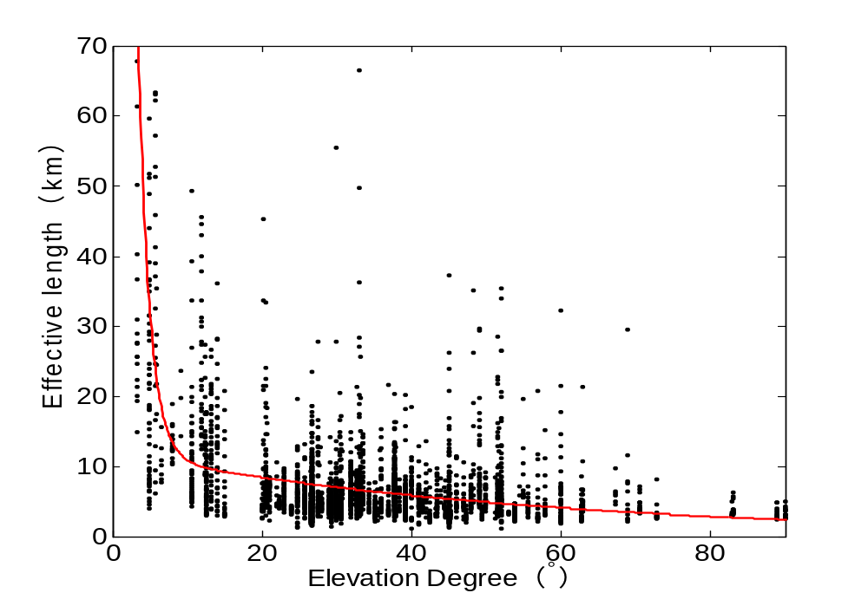
The distribution of effect path length with elevation

Slide 24
Discussions
All of the models are change non-monotonic with the elevation increasing except China_2012 model;
China_2012 model has varied monotonically with elevation which is agrees well with the distribution of measurement data.

Slide 25
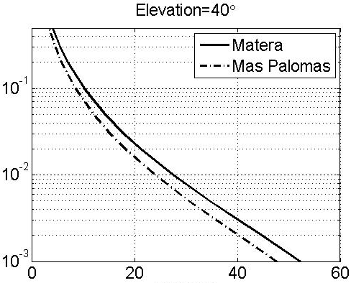
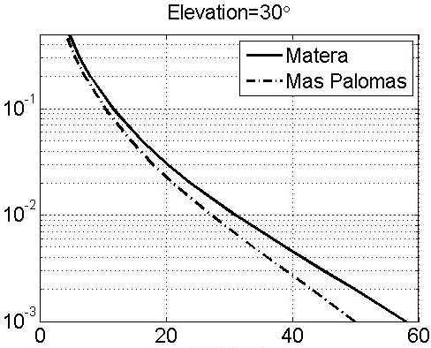


Anomalous behavior of the ITU-R model in low latitude and low elevation
Site | Latitude (deg N) | Longitude (deg E) | Altitude (m) | R(0.01%) (mm/h) | P₀ (%) | H_{R} (km)
Matera (Italy) | +40.39 | +16.42 | 527 | 50.4 | 4.3 | 3.0
Mas Palomas (Canarie Islands) | +27.76 | -15.63 | 205 | 31.2 | 3.4 | 3.4
Attenuation(dB)
Attenuation(dB)

Slide 26
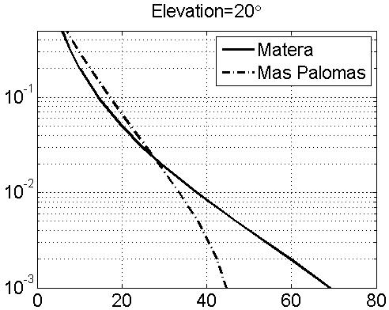
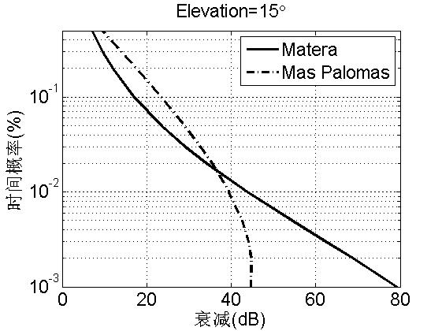


Anomalous behavior of the ITU-R model in low latitude and low elevation(2/2)
Attenuation(dB)
Attenuation(dB)

Slide 27
Discussions
The source of the behaviour has been identified as the β parameter of equation (8) in Recommendation ITU-R P.618-10.
This behaviour may affect the prediction for Earth-space telecommunication systems or Earth-observation systems using non‑GEO satellites.

Slide 28
Conclusions
The China_2012 model obtains the best results for the whole time percentage range;
The China_2012 model and Korea model obtains better results in low latitude;
The China_2012 model improve all the anomalous behaviors.

Slide 29
Content Outline
Rain Attenuation Prediction Models in ITU
Rain Attenuation Prediction Models
Problems of the Models
Comparisons of the Models
Time-Series Synthesizers of Rain Attenuation
Differential Rain Attenuation
Future Work

Slide 30
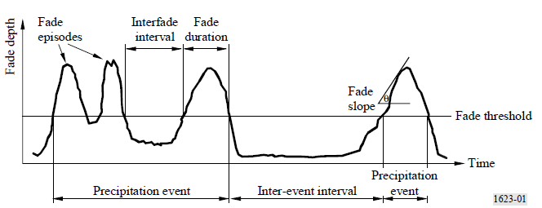
Why need rain attenuation time-series synthesizers ?
The time-series synthesizers can develop and validate propagation channel in the area where is difficult to collect propagation data;
The dynamics of the propagation channel has to be taken into account in the definition of the FMT control loop.

Slide 31
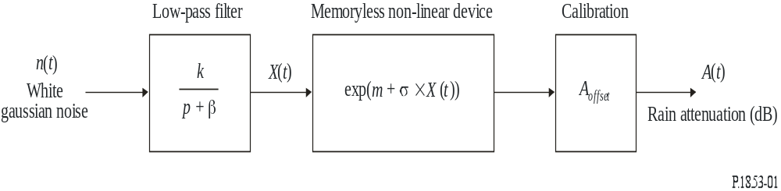
Rain attenuation time series synthesis method in ITU-R P.1853
Block diagram of the rain attenuation time series synthesizer

Slide 32
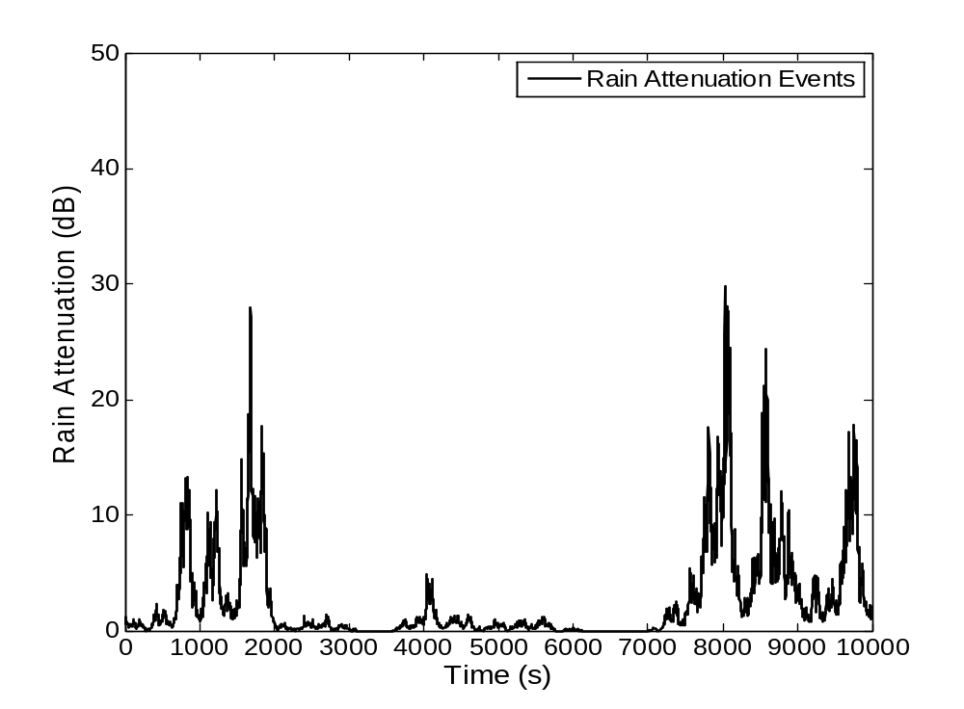
A Time-Series of Rain Attenuation

Slide 33
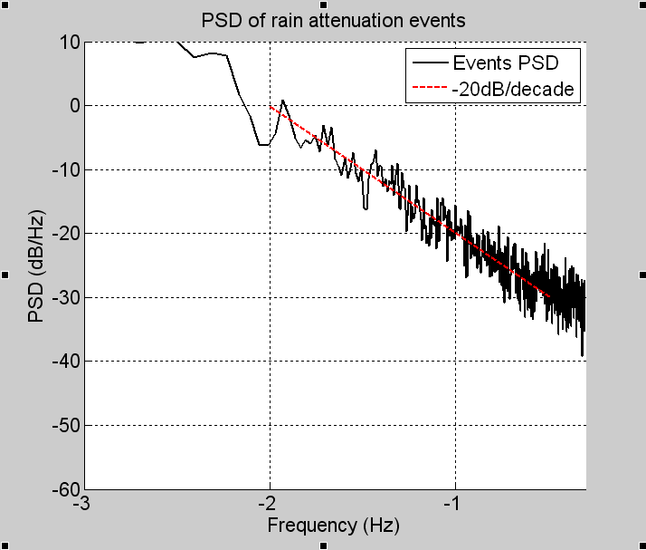
PSD of Rain Attenuation Events

Slide 34
Content Outline
Rain Attenuation Prediction Models in ITU
Rain Attenuation Prediction Models
Problems of the Models
Comparisons of the Models
Time-Series Synthesizers of Rain Attenuation
Differential Rain Attenuation
Future Work

Slide 35
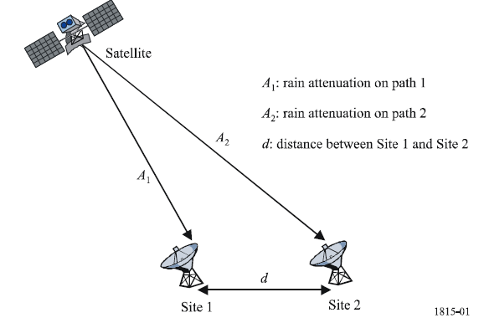
Differential rain attenuation ( ITU-R P.1815)
This recommendation predicts the joint differential rain attenuation statistics between a satellite and two locations on the surface of the Earth.

Slide 36



Prediction Method
The joint probability that the attenuation on the path to the first site is greater than a1 and the attenuation on the path to the second site is greater than a2.
: joint probability that it is raining at both sites.
: conditional joint probability that the attenuations exceed a1 and a2,respectively.

Slide 37
Content Outline
Rain Attenuation Prediction Models in ITU
Rain Attenuation Prediction Models
Comparisons of the Models
Problems of the Models
Time-Series Synthesizers of Rain Attenuation
Differential Rain Attenuation
Future Work

Slide 38
Proposal for Ka project
Collecting rainfall and attenuation data in low latitudes or high elevations;
Test and Validating the rain attenuation models in low latitudes and high elevations;
Developing or modifying model of rain attenuation model ;
Other works.

Slide 39

Thanks for Your Attention!

